Slide 1
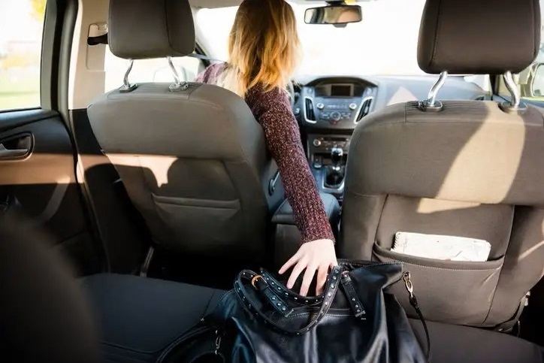
Distracted Driver Detection System
Group 8
Binbin Xia
Anderson Klein
Shruti Deshpande Kyeongho Min

Slide 2
Agenda
(1) Background
(2) Statement of Problem
(3) Dataset Exploration
(4) Model Description
(5) Training and Test Results
(6) Application

Slide 3
Background
Distracted driving refers to the act of driving while engaging in any activity that can divert the driver’s attention away from the road e.g., texting, eating, talking on the phone, operating radio, reaching behind, etc.
According to the CDC Motor Vehicle Safety Division, 1 in 5 car accidents is caused by a distracted driver.
In 2018, distracted driving has claimed 2,841 lives in United States. Among those killed: 1,730 drivers, 605 passengers, 400 pedestrians and 77 bicyclists.

Slide 4
Statement of Problem
Goal: Design a Distracted Driver Detection System to help dashboard cameras automatically detect driver engaging in distracted behaviors, which can be applied to the system to enforce laws against driving behaviors.

Slide 5
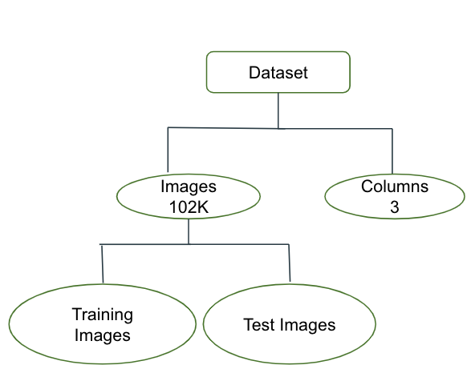
Dataset Overview
This dataset consists of 102150 input images and 3 columns.
Notes:
Following is the file descriptions
imgs.zip - zipped folder of all (training) images

Slide 6
Dataset Overview
Class | Description
C0 | Safe Driving
C1 | Texting - Right
C2 | Talking on the Phone - Right
C3 | Texting - Left
C4 | Talking on the Phone - Left
C5 | Operating the Radio
C6 | Drinking
C7 | Reaching Behind
C8 | Hair and Makeup
C9 | Talking to the passenger

Slide 7
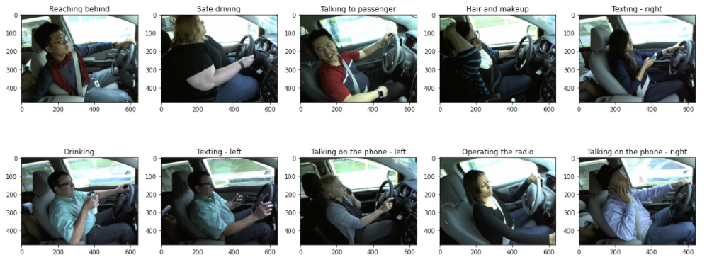
Dataset Overview
Notes:
Following is the file descriptions
imgs.zip - zipped folder of all (training) images

Slide 8
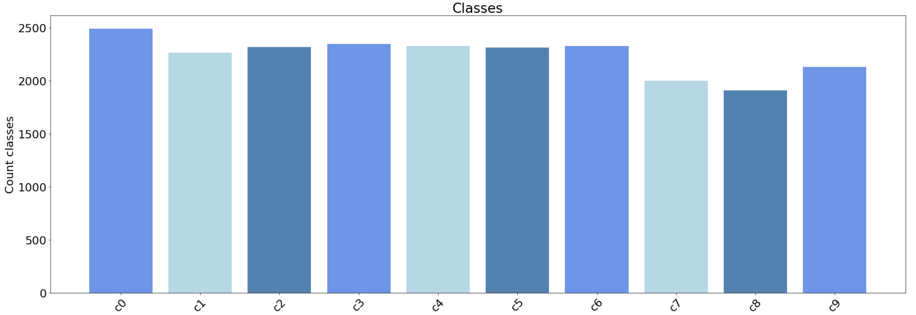
Dataset Overview
Notes:
Following is the file descriptions
imgs.zip - zipped folder of all (training) images

Slide 9
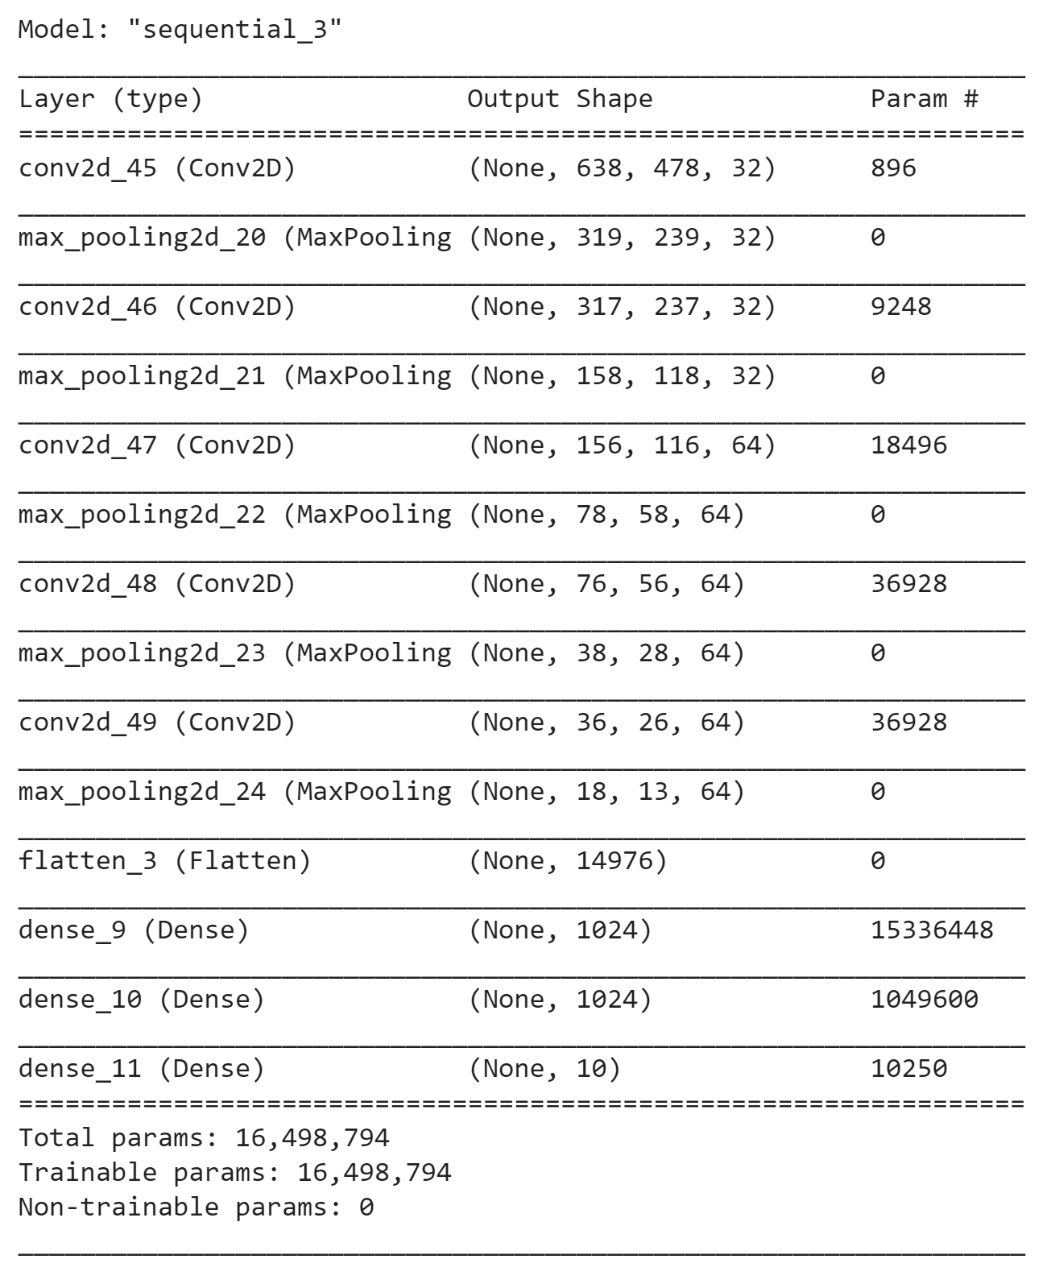
Model Architecture
3x3 maps with max pooling
Deep Feedforward for output
Nadam loss
ReLu activation

Slide 10
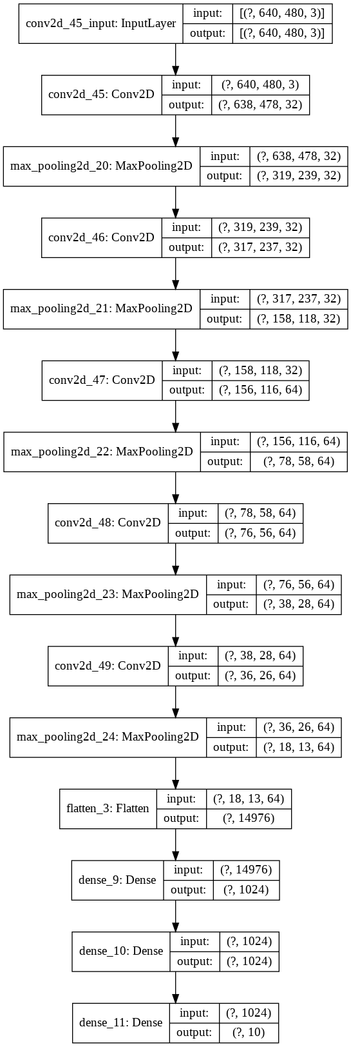
Model Architecture Iteration
What worked
Adding More Layers
Doubling the DFF layer
Increasing input size
What did not work
Depthwise filtering
Padding
More epochs

Slide 11

Training Setup
Storage: Google Drive
Software: Colab
Hardware: Tesla T4

Slide 12
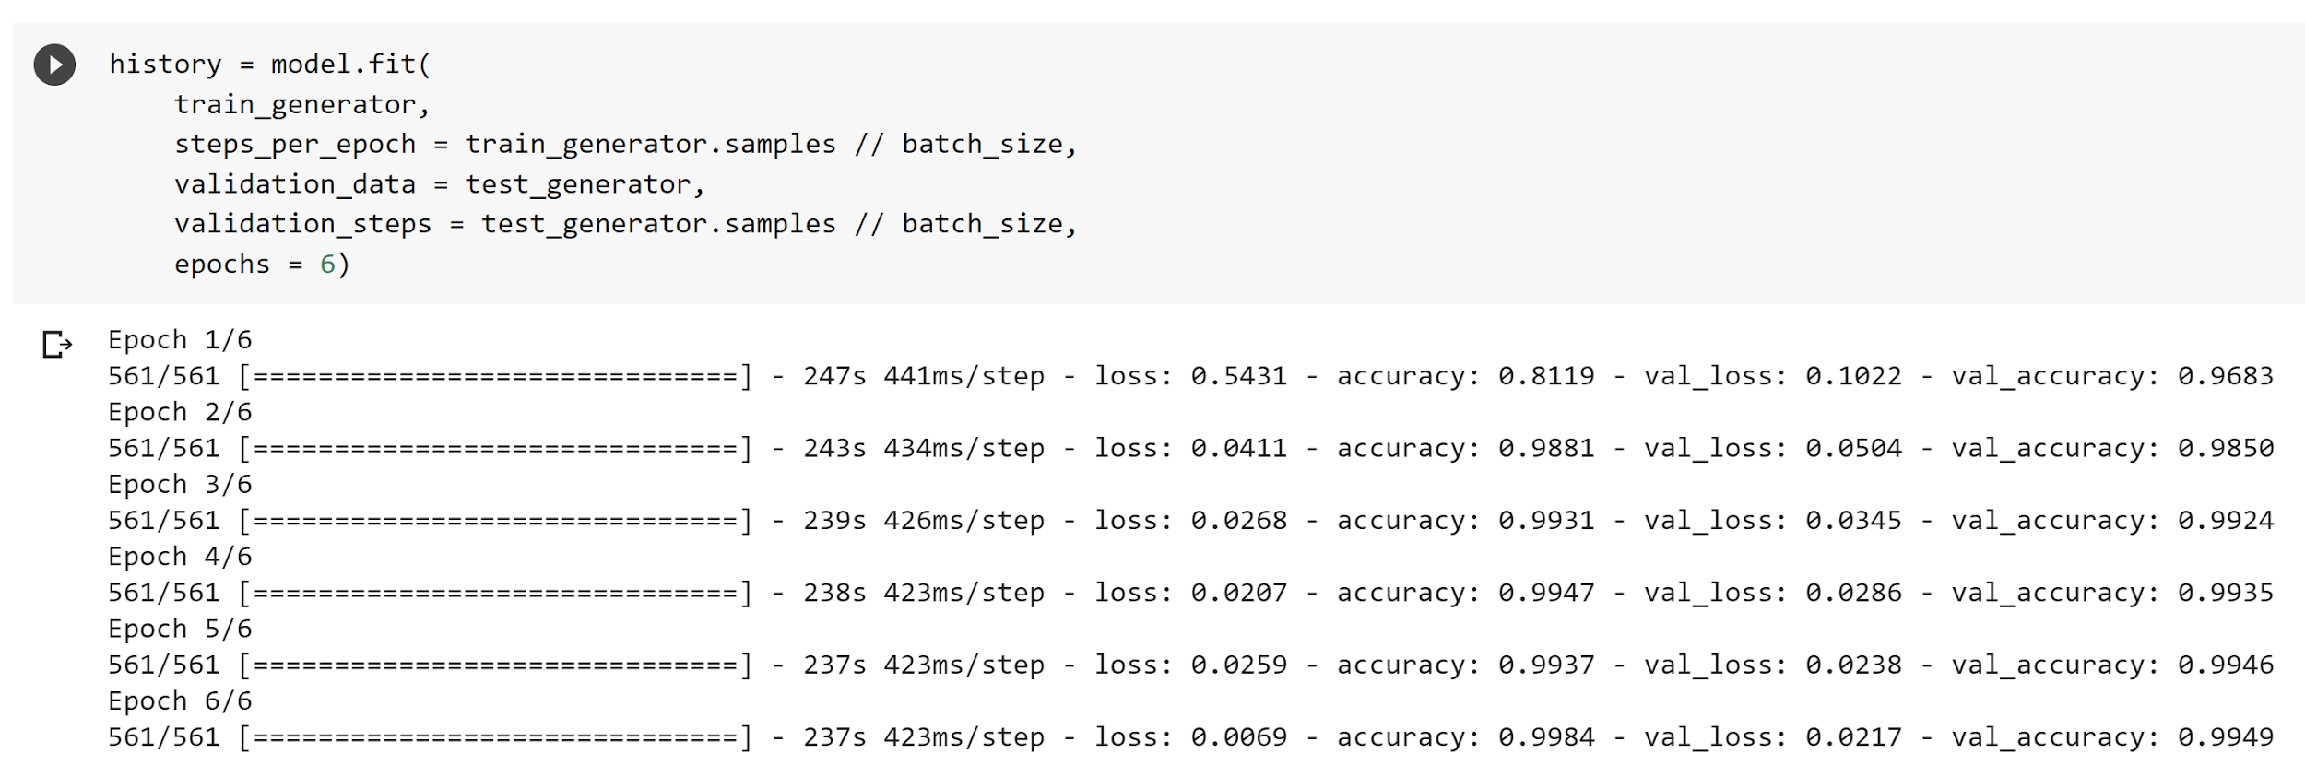
Training Results

Slide 13
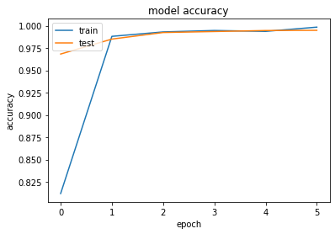
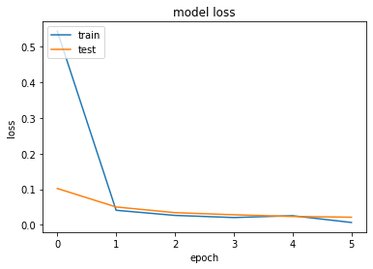
Training Graphs

Slide 14
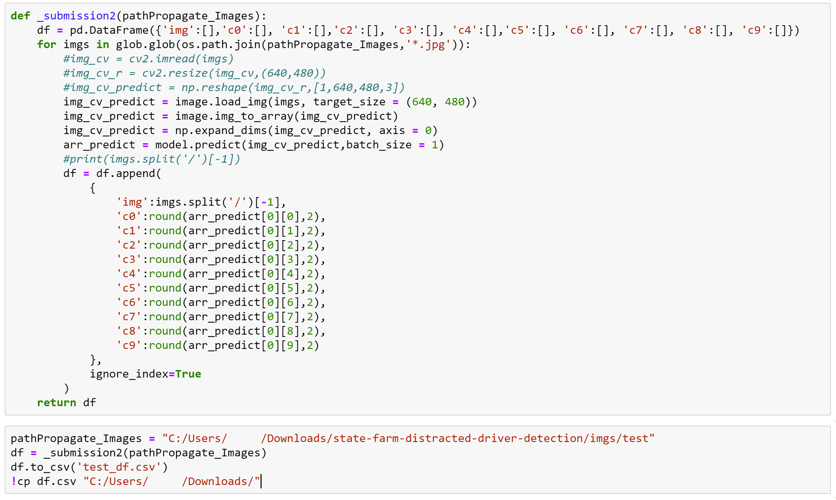
Testing Code for Competition Submit
Bad
Good
Improved Performance If Batch Was Used

Slide 15
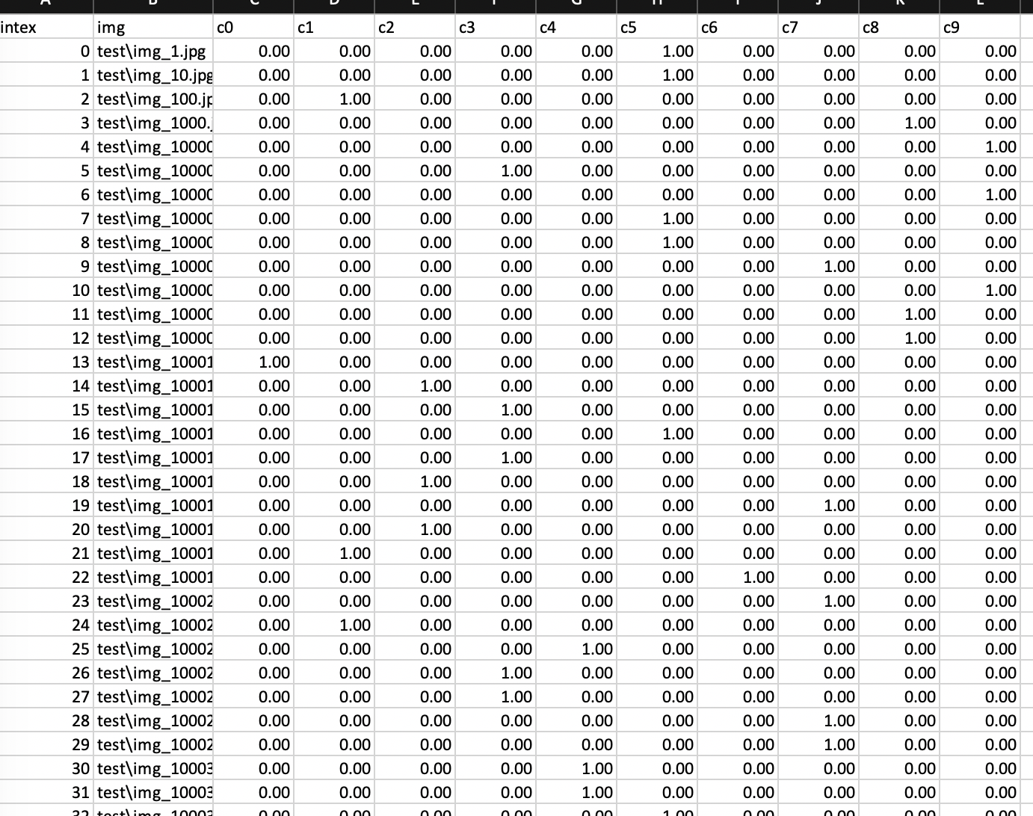
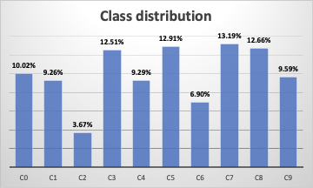
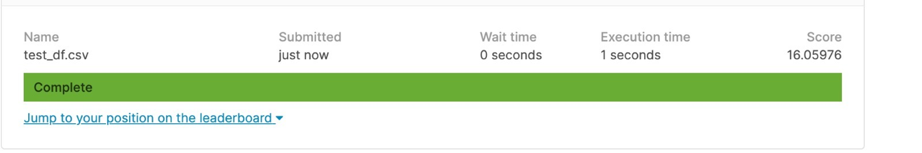
Testing Result
79725 * 10 dataset

Slide 16
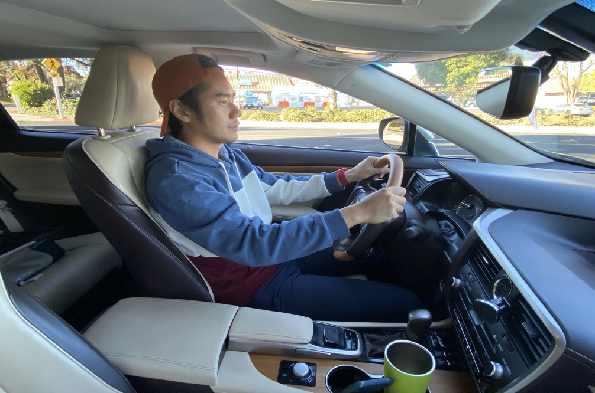
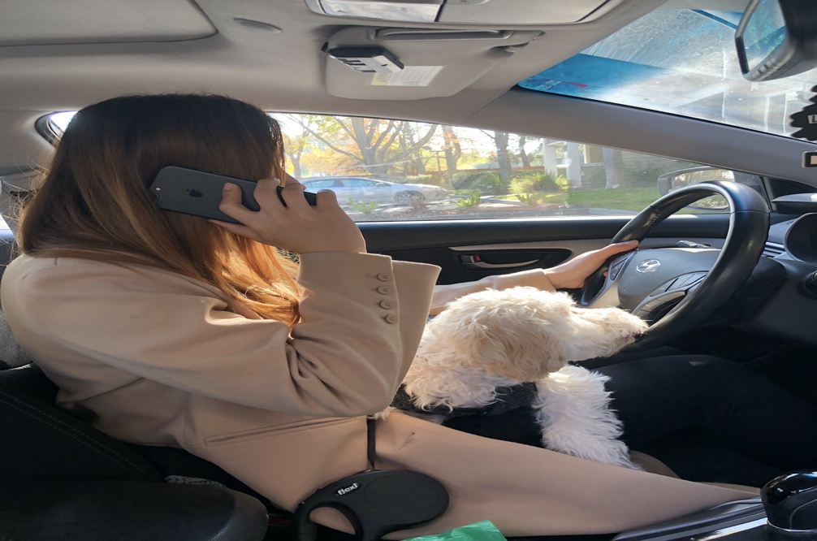
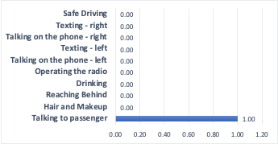
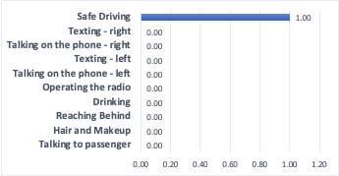
Model Prediction
<Safe Driving>
<Talking on the phone - right>

Slide 17
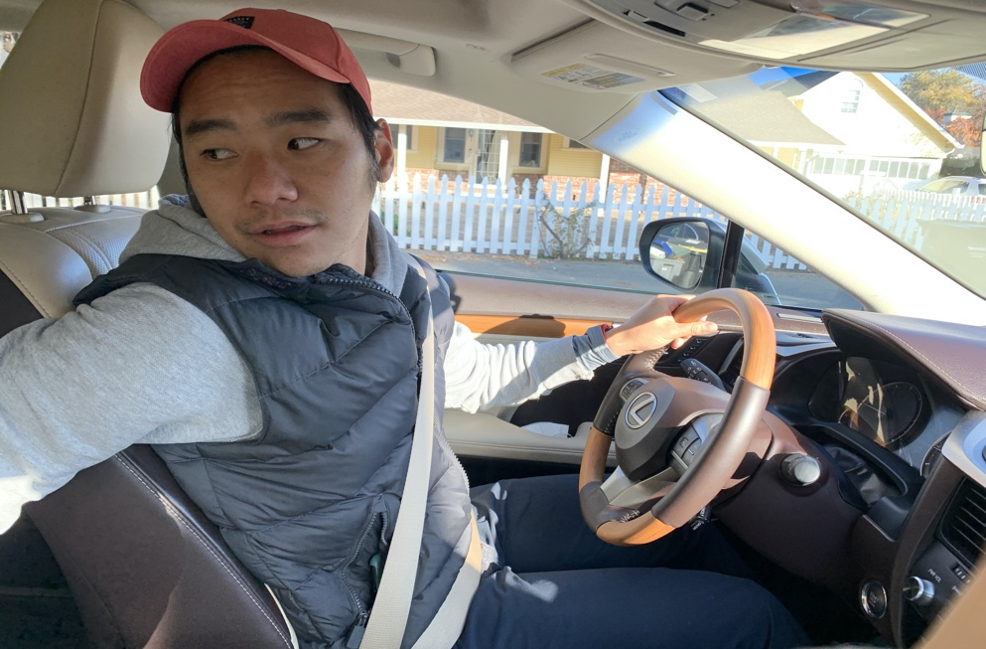
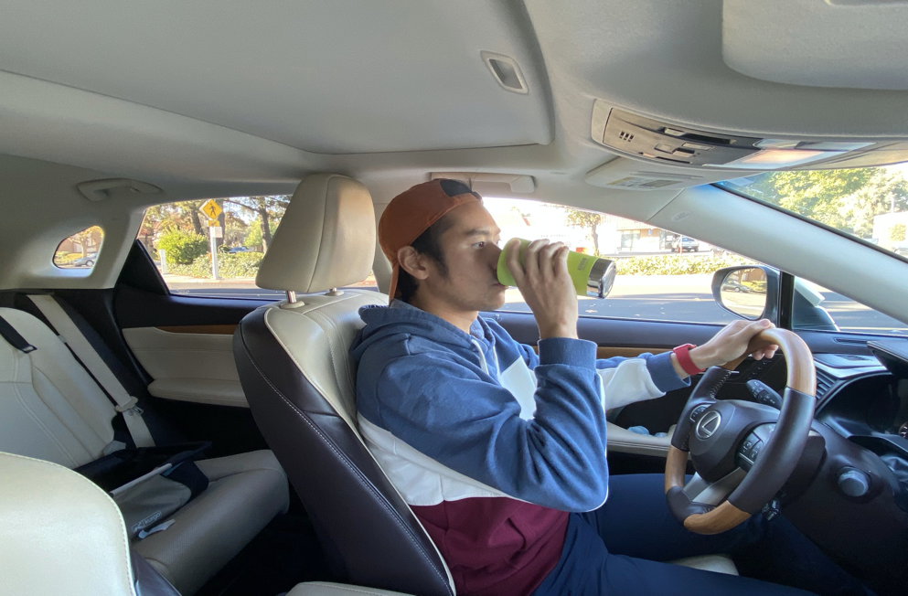
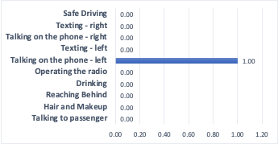
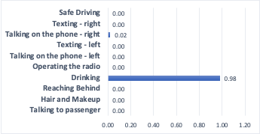
Model Prediction
<Reaching behind>
<Drinking>

Slide 18
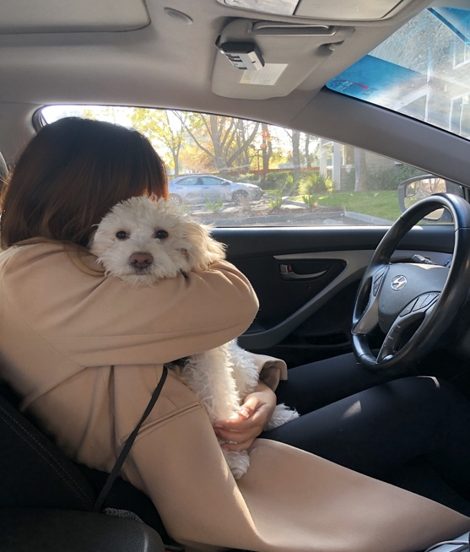
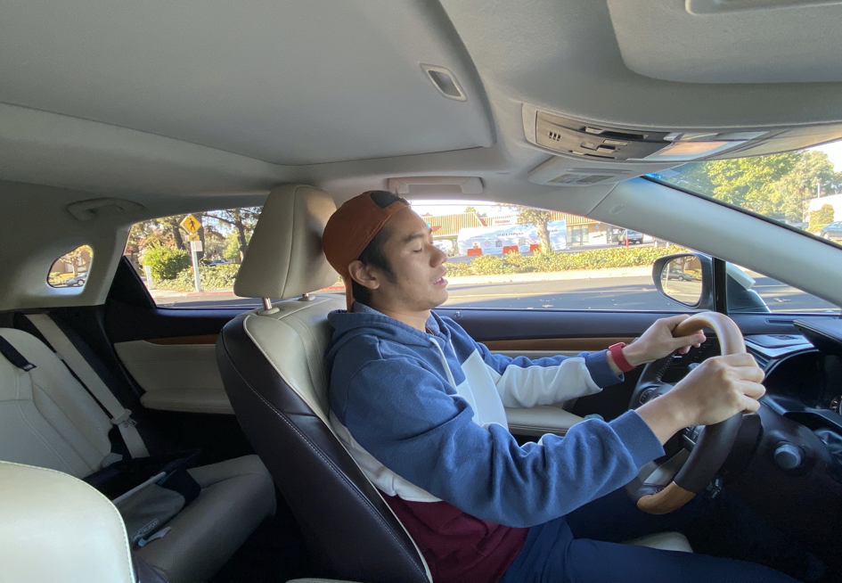
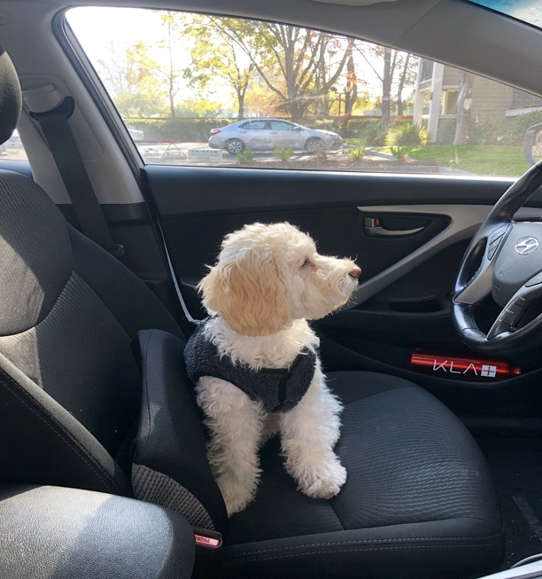
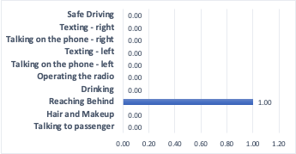
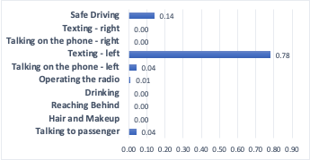
Model Prediction(exception)
<Driving with pet>
<Sleeping>
<Dog driving>

Slide 19
Application
We will keep revising the model and will choose the model that give us the best accuracy score into our Distracted Driver Detection System.
By utilizing this system:
Help the government, local police or insurance company to identify dangerous driving behaviors and enact related laws/policy.
Apply this algorithm into a device with a camera installed in cars that tracks the driver movements, which can prevent accidents.

Slide 20
How to improve?
Adding more distracted behaviors images into the dataset
Adding more layers into the model
Testing different training rates among other hyper parameter tuning
Image data augmentation (more noise/ artifacts)
Transfer learning

Slide 21
Thank You
Any Questions?

